Slide 1
Deep Learning and Text Mining
Will Stanton
Ski Hackathon Kickoff Ceremony, Feb 28, 2015

Slide 2
We have a problem
At Return Path, we process billions of emails a year, from tons of senders
We want to tag and cluster senders
Industry verticals (e-commerce, apparel, travel, etc.)
Type of customers they sell to (luxury, soccer moms, etc.)
Business model (daily deals, flash sales, etc.)
It’s too much to do by hand!

Slide 3
What to do?
Standard approaches aren’t great
Bag of words classification model (document-term matrix, LSA, LDA)
Have to manually label lots of cases first
Difficult with lots of data (especially LDA)
Bag of words clustering
Can’t easily put one company into multiple categories (ie. more general tagging)
Needs lots of tuning
How about deep learning neural networks?
Very trendy. Let’s try it!

Slide 4
Neural Networks
Machine learning algorithms modeled after the way the human brain works
Learn patterns and structure by passing training data through “neurons”
Useful for classification, regression, feature extraction, etc.
Inputs
x = (x1, x2, x3)
Output y
Output
Layer
Input Layer
Second Hidden Layer
First Hidden Layer

Slide 5
Deep Learning
Neural networks with lots of hidden layers (hundreds)
State of the art for machine translation, facial recognition, text classification, speech recognition
Tasks with real deep structure, that humans do automatically but computers struggle with
Should be good for company tagging!

Slide 6
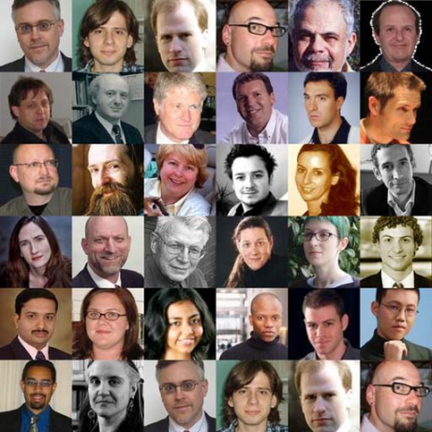
Distributed Representations
Collection of faces
Edges
Shapes
Typical facial types (features)
Pixels
Human brain uses distributed representations
We can use deep learning to do the same thing with words (letters -> words -> phrases -> sentences -> …)

Slide 7
Deep Learning Challenges
Computationally difficult to train (ie. slow)
Each hidden layer means more parameters
Each feature means more parameters
Real human-generated text has a near-infinite number of features and data
ie. slow would be a problem
Solution: use word2vec

Slide 8
word2vec
Published by scientists at Google in 2013
Python implementation in 2014
gensim library
Learns distributed vector representations of words (“word to vec”) using a neural net
NOTE for hardcore experts: word2vec does not strictly or necessarily train a deep neural net, but it uses deep learning technology (distributed representations, backpropagation, stochastic gradient descent, etc.) and is based on a series of deep learning papers

Slide 9
What is the output?
Distributed vector representations of words
each word is encoded as a vector of floats
vec_{queen}= (0.2, -0.3, .7, 0, … , .3)
vec_{woman} = (0.1, -0.2, .6, 0.1, … , .2)
length of the vectors = dimension of the word representation
key concept of word2vec: words with similar vectors have a similar meaning (context)

Slide 10
word2vec Features
Very fast and scalable
Google trained it on 100’s of billions of words
Uncovers deep latent structure of word relationships
Can solve analogies like King::Man as Queen::? or Paris::France as Berlin::?
Can solve “one of these things is not like another”
Can be used for machine translation or automated sentence completion

Slide 11
How does it work?
Feed the algorithm (lots of) sentences
totally unsupervised learning
word2vec trains a neural net that encodes the context of words within sentences
“Skip-grams”: what is the probability that the word “queen” appears 1 word after “woman”, 2 words after, etc.

Slide 12
word2vec at Return Path
At Return Path, we implemented word2vec on data from our Consumer Data Stream
billions of email subject lines from millions of users
fed 30 million unique subject lines (300m words) and sending domains into word2vec (using Python)
Lots of subject lines
word2vec
word vectors
insights

Slide 13
Grouping companies with word2vec
Find daily deals sites like Groupon
[word for (word, score) in model.most_similar('groupon.com', topn = 100) if '.com' in word]
['grouponmail.com.au', 'specialicious.com', 'livingsocial.com', 'deem.com', 'hitthedeals.com', 'grabone-mail-ie.com', 'grabone-mail.com', 'kobonaty.com', 'deals.com.au', 'coupflip.com', 'ouffer.com', 'wagjag.com']
Find apparel sites like Gap
[word for (word, score) in model.most_similar('gap.com', topn = 100) if '.com' in word]
['modcloth.com', 'bananarepublic.com', 'shopjustice.com', 'thelimited.com', 'jcrew.com', 'gymboree.com', 'abercrombie-email.com', 'express.com', 'hollister-email.com', 'abercrombiekids-email.com', 'thredup.com', 'neimanmarcusemail.com']

Slide 14
More word2vec applications
Find relationships between products
model.most_similar(positive=['iphone', 'galaxy'], negative=['apple']) = ‘samsung’
ie. iphone::apple as galaxy::? samsung!
Distinguish different companies
model.doesnt_match(['sheraton','westin','aloft','walmart']) = ‘walmart’
ie. Wal Mart does not match Sheraton, Westin, and Aloft hotels
Other possibilities
Find different companies with similar marketing copy
Automatically construct high-performing subject lines
Many more...

Slide 15
Try it yourself
C implementation exists, but I recommend Python
gensim library: https://radimrehurek.com/gensim/
tutorial:http://radimrehurek.com/gensim/models/word2vec.html
webapp to try it out as part of tutorial
Pretrained Google News and Freebase models: https://code.google.com/p/word2vec/

Slide 16
Thanks for listening!
Many thanks to:
Data Science Association and Level 3
Michael Walker for organizing
Slides posted on http://will-stanton.com/
Email me at will@will-stanton.com
Return Path is hiring! Voted #2 best midsized company to work for in the country http://careers.returnpath.com/

