Slide 1
Real-Time Analysis for High-Frequency Trading
Your Data Needs to Be Faster,
Not Just Bigger
© 2015 Lee A Cole

Slide 2
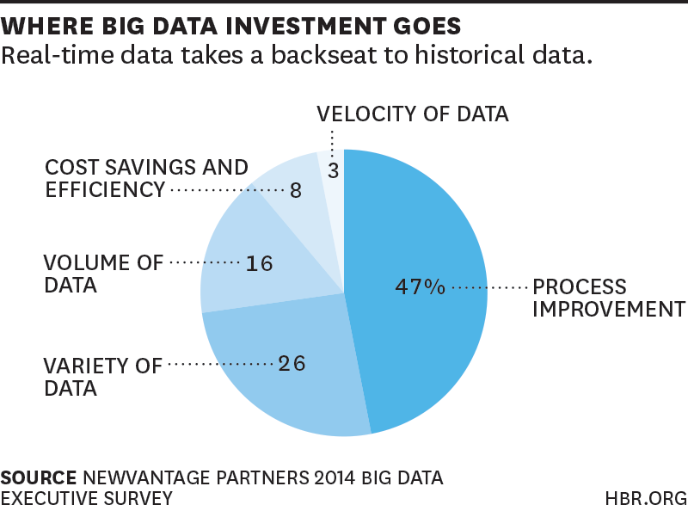
Harvard Business Review Feb 2015
© 2015 Lee A. Cole

Slide 3
Real-Time Analysis
Overview
Specific Example being securities trading
Three Points
You need to be faster
Faster is probably faster than you think
Have a(n automated) strategy for missing or bad data.
© 2015 Lee A Cole

Slide 4
Real-Time Analysis
What is High-Frequency Trading?
Trading, not investing
Start holding no positions
Finish holding no positions
Buy/Sell millions of shares during the day
Move into and out of a position in minutes, seconds, even milliseconds
Microseconds soon
NASDAQ will respond in ~100 nanoseconds after an order hits its machines
© 2015 Lee A Cole

Slide 5
Real-Time Analysis
Data Volumes
Market Data Volumes & Rates
US Listed Equities ~5 Billion messages/day
US Options 10-100 changes per equity change
FOREX higher still
Futures, commodities, OTC, pink sheet, overseas…
Other data sources:
SEC filings
News
Social media
© 2015 Lee A Cole

Slide 6
Real-Time Analysis
Data Volumes
Trading Message Volumes
~20 orders placed per order executed
95% cancel rates
Have seen one trader place 20+ million orders / day
Each order may have 5 or more messages involved
Trade messages are far more variable (format) than market data
© 2015 Lee A Cole

Slide 7
Real-Time Analysis
Implications
Short decision timeframes
milliseconds at most, microseconds common
Mistakes can be expensive
OTS tools generally too slow
Custom code, hand tuned
FPGAs (trading, not analysis)
Custom ASICs (market data servers)
© 2015 Lee A Cole

Slide 8
Real-Time Analysis
Implications (cont.)
Competitive pressures
Preplanned, automated strategies
missing, noisy, or misleading data
missing data, if resent, will be stale and of little use
Network noise, garbage collection times, page swapping delays can be killers
Databases are slow
© 2015 Lee A Cole

Slide 9
Real-Time Analysis
You must be faster than you think
Queues
Arrival times vary
And are outside of your control
Utilization
p =average time to process a message/
average time between messages
Rule of thumb:
Average queue depth = p/(1-p)
© 2015 Lee A Cole

Slide 10
Real-Time Analysis
© 2015 Lee A Cole

Slide 11
Real-Time Analysis
© 2015 Lee A Cole

Slide 12
Real-Time Analysis
Keep utilization low (<20-25%)
A bored cpu can respond quickly
Applies to network and disk i/o as well
How?
Algorithms
Simple design (simple usually runs faster)
Tight coding
Buffers not objects
Measure/monitor constantly
Things always change. Know how, and how it impacts the analysis
© 2015 Lee A Cole

Slide 13
Real-Time Analysis
Wrap Up
Your data should be faster, not just bigger
Competitive pressures will force it
IOT => more real-time data
Utilization rates should be ~20-25% or less
Automated strategies for data cleaning
As part of your normal processing time
You won’t have time otherwise
© 2015 Lee A Cole

Slide 14
Real-Time Analysis
Real-Time Analysis for
High-Frequency Trading
Your Data Should Be Faster, Not Just Bigger
Lee A Cole, PhD
leecole@gmail.com
+1 720 985-4716
© 2015 Lee A Cole

