Slide 1
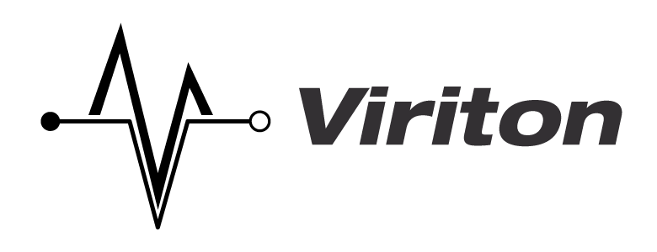
Infrastructure and Stack
Presented by John Dougherty, Viriton
4/28/2015
john.dougherty@viriton.com
Notes:
Welcome, and do let me know if you have any questions about the technology

Slide 2
What is Hadoop?
Apache’s implementation of Google’s BigTable
Uses a Java VM in order to parse instructions
Uses sequential writes & column based file structures with HDFS
Grants the ability to read/write/manipulate very large data sets/structures.
Notes:
White papers led the way for distributed open source platforms
Java has extended much farther than the bytecode of yore
Column based databases use sequential writes & columns
A larger aperture for a, hopefully, more impactful result

Slide 3
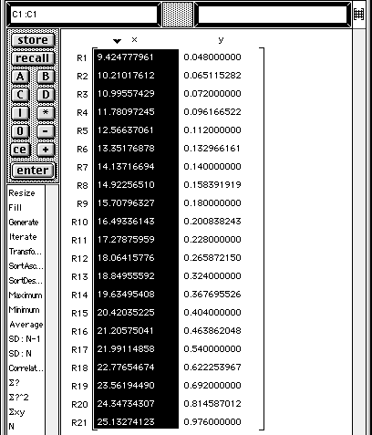
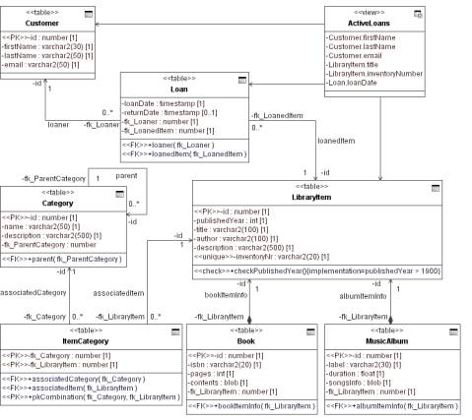
What is Hadoop? (cont.)
VS.
Notes:
On the left is a key-value table, which is the foundation of Hadoop
On the right is a classic ERD for a schema based relational database
This is the primary fork, which is becoming more and more of a blurred line using current tools

Slide 4
What is BigTable
Contains the framework that was based on, and is used in, hadoop
Uses a commodity approach to hardware
Extreme scalability and redundancy
Is a compressed, high performance data storage system built on Google’s File System
Notes:
The framework was built to conform to use…
…in order to utilize…
…which has led to the revolution in the capabilities of current large datasets

Slide 5
Commodity Perspective
Commercial Hardware cost vs. failure rate
Roughly double the cost of commodity
Roughly 5% failure rate
Commodity Hardware cost vs. failure rate
Roughly half the cost of commercial
Rougly 10-15% failure rate
Notes:
Industrial grade costs
This makes it more difficult to deploy in some circumstances
This benefit comes at extraneous costs if you have an existing enterprise commercial offsite or DR solution

Slide 6
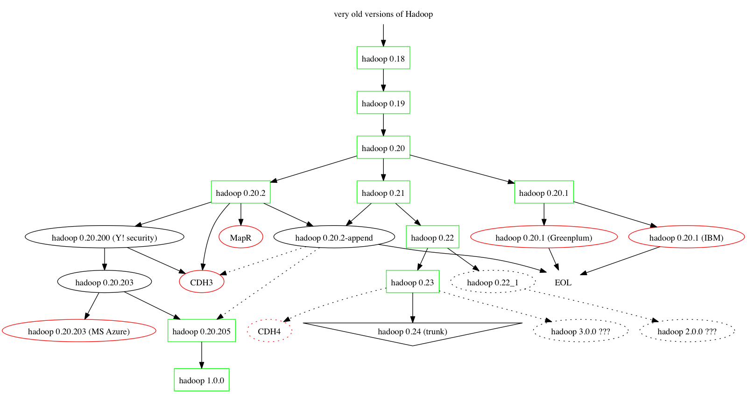
Breaking Down the Complexity
Notes:
As we move into new territory with current systems utilizing new stacks, we also have older forks that are becoming unsupported or less supported.

Slide 7
What is HDFS
Backend file system for the Hadoop platform
Allows for easy operability/node management
Certain technologies can replace or augment
Hbase (Augments HDFS)
Cassandra (Replaces HDFS)
Notes:
An integral part of Hadoop, a necessity
Centralized management and deployment using both open source and closed source tools
Different problems require different solutions

Slide 8
What works with Hadoop?
Middleware and connectivity tools improve functionality
Hive, Pig, Cassandra (all sub-projects of Apache’s Hadoop) help to connect and utilize
Each application set has different uses
Pig
Notes:
Brief overview, will explain more in later slides

Slide 9
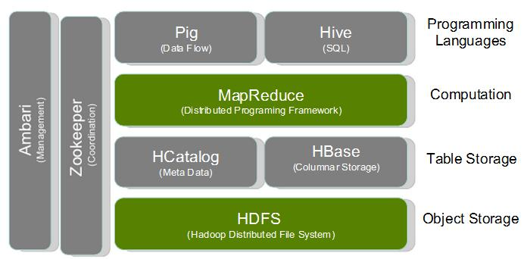
Layout of Middleware
Notes:
This is a fairly simple stack that could be in any back office or production setup

Slide 10
Schedulers/Configurators
Zookeeper
Helps you in configuring many nodes
Can be integrated easily
Oozie
A job resource/scheduler for hadoop
Open source
Flume
Concatenator/Aggregator (Dist. log collection)
Notes:
These tools allow for interactivity and automation, zookeeper is being utilized more and more by the Ambari software, an easier variant

Slide 11
Middleware
Hive
Data warehouse, connects natively to hadoop’s internals
Uses HiveQL to create queries
Easily extendable with plugins/macros
Pig
Hive-like in that it uses its own query language (pig latin)
Easily extendable, more like SQL than Hive
Sqoop
Connects databases and datasets
Limited, but powerful
Notes:
Hive
Front end using SQL like statements
Extending is relatively straightforward in that the language is relatable
Pig
Its language extensibility is more restricted, but users report it to be a
bit easier of a learning curve
Sqoop
An interactive layer that can help with working realtime workflows
(Though I should mention that Spark is doing some really cool things,
along with Pentaho)

Slide 12
How can Hadoop/Hbase/MapReduce help?
You have a very large data set(s)
You require results on your data in a timely manner
You don’t enjoy spending millions on infrastructure
Your data is large enough to cause a classic RDBMS headaches
Notes:
Don’t go too deep here…

Slide 13
Column Based Data
Developer woes
- Extract/Transfer/Load is still a concern for complicated schemas
- Egress/Ingress between existing queries/results becomes complicated
- Solutions are deployed with walls of functionality
- Hard questions turn into hard queries
Notes:
Flattening databases can become complicated…sometimes impossible
Tools to develop solutions are becoming more prevalent, but there hasn’t been much cream to rise to the top

Slide 14
Column Based Data (cont.)
Developer joys
You can now process PB, into EB, and beyond
Your extended datasets can be aggregated, not easily; but also unlike ever before
You can extend your daily queries to include historical data, even incorporating into existing real-time data usage
Notes:
The benefits can far outweigh the costs, but there’s a whole other presentation for that.

Slide 15
Future Projects/Approaches
Cross discipline data sharing/comparisons
Complex statistical models re-constructed
Massive data set conglomeration and standardization (Public sector data, etc.)
Notes:
Self explanatory, I think

Slide 16
How some software makes it easier
Alteryx
Very similar to Talend for interface, visual
Allows easy integration into reporting (Crystal Reports)
Qubole
This will be expanded on shortly
Easy to use interface and management of data
Hortonworks (Open Source)
Management utility for internal cluster deployments
Cloudera (Open, to an extent)
Management utility from Cloudera, also for internal deployments

