Slide 1
Big Sensor Data; Little Networks: How Sensors Will Define Data System Architecture
CHRIS HOWARD
Founder, Kersplody
cehoward@kersplody.com
Notes:
With 10+ years project management and development experience at Lockheed Martin and NASA, I have shaped many of the Federal Government's largest data processing and remote sensing solutions for things like satellite downlinks and monitoring all .gov internet traffic. I joined with Tim Gruhl, my skunk works cofounder, to develop a key missing component in the big data ecosystem that we wish we had when architecting these huge systems.
Kersplody enables organizations to easily publish and share compile-once algorithms across multiple technologies, including Storm, Spark, and MapReduce, while reducing the impacts of infrastructure upgrades.

Slide 2
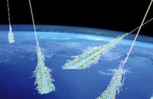
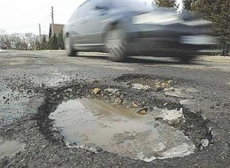
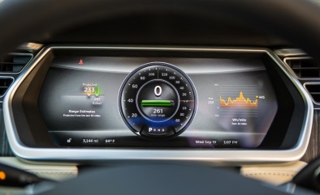
Over 99.5% of all data is not being leveraged
Notes:
Right now, over 99.5% of all data generated is not being leveraged. For example, your car, if it was manufactured in the last five years, likely generates around 25 Gigabytes of data per hour across 200+ sensors, but doesn't do much more with this data than keep the engine running and throw a few bits per second at the dash. However, this data is potentially useful for a number of hard problems, such as air quality monitoring, predicting localized weather, surveying the road condition, or even measuring cosmic ray activity.
Working with this kind of data is challenging: Requiring expert staff and constant infrastructure refreshes to keep everything running. Organizations need to be able to focus development efforts on the algorithms instead of the infrastructure while making it easy for everyone to discover, try, assemble, and deploy capabilities.
Not just cars stuffed with sensors -- from toasters to cell phones to shoes are getting IP addresses and pushing data to the internet.
Military terabit video sensors and terabit RF devices flying around. Data had to be significantly reduced before it reached the hard drive, getting data to the ground terminal – and sensor data collection rates are growing significantly faster than available bandwidth.
Losing a lot of data before you could even do your batch and real time processing – and that’s before you even consider the complete lack of algorithm and workflow portability across devices
Data OMNISCIENCE is all about how to build the software and tools needed to address this problem.

Slide 3
Real Embedded Systems
Database
Mission Computer
COMMs
Control Services
Sensor Specific C2
RIU
Sensor Specific Data Formatter
Sensor
Data Processing
Algo 1
Algo 1 Service
Sensor Specific C2
RIU
Sensor Specific Data Formatter
Sensor
Algo 2
Algo 2 Service
Sensor Specific C2
RIU
Algo 3
Algo 3 Service
Sensor Specific Data Formatter
Sensor
Algo 4
Algo 4 Service
Sensor Specific C2
RIU
Algo 5
Algo 5 Service
Sensor Specific Data Formatter
Sensor
Algo 6
Algo 6 Service
Sensor Specific C2
RIU
Algo 7
Algo 7 Service
Sensor
Sensor Specific Data Formatter
Sync
Notes:
How to glue the algorithms to the sensors to the networks without creating unneeded stovepipes for each application

Slide 4
Today
Tomorrow
Disk
Stream Processing
Disk
Stream Processing
Disk
Stream Processing
Disk
Stream Processing
Batch Processing
Stream Processing
Sensor
Stream Processing
Data
Records
Stream Processing
Sensor
Stream Processing
Stream Processing
Sensor
Batch Processing
Batch Processing
Data
Records
Batch Processing
Notes:
Requirements:
Needs to be substantially open source and not vendor locked
Need to do dev/integration/ops on unified hardware
Need to be able to separate DEV from OPS
Need to be able to separate Workflows from Algorithms
Need to be able to flexibly move workflows and algos around -> between local, remote, batch, streaming, hybrid local remote streaming processing etc.
Need to be able to securely run these components – need to be able to trust that workflows and algos wont do anything purposely or accidentally malicious
Need to be able to put capabilities on the shelf and have some reasonable guarantee that they are usable in the future
Need to make it easy for end users to discover and assemble algos/analytics with minimal developer involvement
Need to be able to have chargeback for these components
Need to be able to map the appropriate components to the right resources (GPUs/DSPs/Networking)
Need to be able to manage and model CPU/Network/Memory requirements

Slide 5
Summary
Sensors are everywhere, lots of untapped potential
Bandwidth will remain limited
Most processing and decisioning will be made in the streaming domain
The current shortcomings of big data become more pronounced: Infrastructure Insanity, Sharing Difficulties, Non-Modular Everything

Slide 6
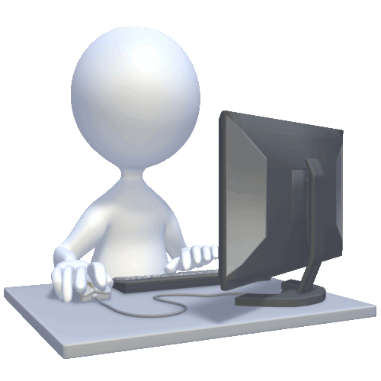
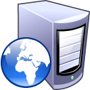
Capabilities
Algorithms
Analytics
Dashboards
Visualizations
Tuning Tools
App Integrations
Notes:
Standardized processing environment
Quickly & cheaply integrate algorithms & sensors onto platforms
Efficiently ties together sensors to users
Correct interfaces in the correct location
Bridges sensor meshes
True, timely interaction

Slide 7
Thank You

